Slide 1
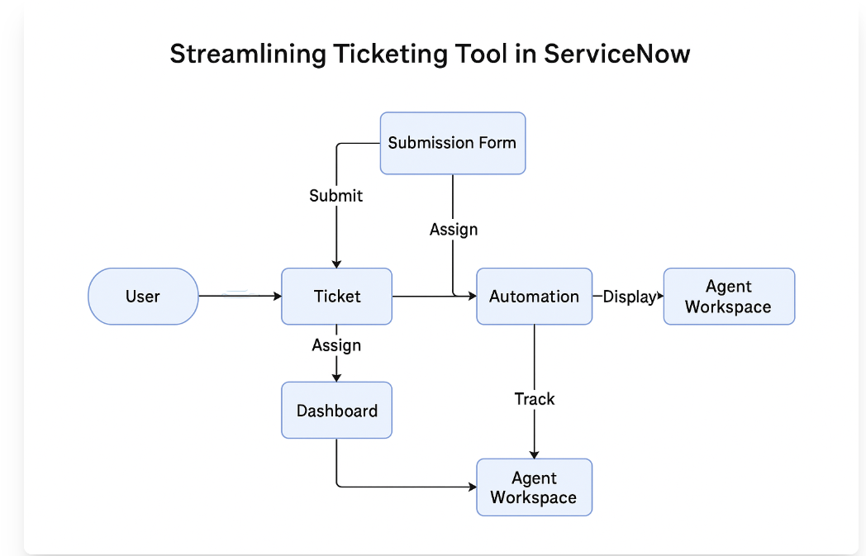
Data Flow Diagram & User Stories
Date: 31 January 2025
Team ID: LTVIP2025TMID28553
Project Name: Streamlining Ticket Assignment for Efficient Support Operations
Maximum Marks: 4 Marks
Data Flow Diagrams
A Data Flow Diagram (DFD) is a visual representation of how data flows through a system. For this project, the DFD shows how a user creates a ticket, how it's processed and routed by the ServiceNow system, and how agents handle and resolve it. The diagram captures data inputs, processing steps, storage (ticket DB), and outputs such as notifications or resolution logs.

Slide 2
User Stories
User Type | Functional Requirement | Story Number | User Story / Task | Acceptance Criteria | Priority
Employee | Ticket Submission | USN-1 | As a user, I can create a support ticket | Ticket is logged and assigned | High
Employee | Status Tracking | USN-2 | As a user, I can track the ticket status | Status is updated and visible | Medium
Support Agent | Ticket Assignment | USN-3 | As an agent, I receive tickets auto-assigned | Tickets are assigned correctly | High
Support Agent | SLA Monitoring | USN-4 | As an agent, I get SLA alerts for high-priority | Alerts are received before SLA | High
Admin | Report Generation | USN-5 | As an admin, I can generate weekly ticket stats | Ticket stats are generated successfully | Medium

